Slide 1
Ted wants a credit card!
Lesson 3: Borrowing Money, Part 1
Notes:
Students have a lifetime of consumer decisions: When they know their rights they will not only obtain wealth- they will keep it.

Slide 2

Say hello to Ted!
Ted wants to apply for his first credit card. He doesn’t know much about how credit works, and wants to make a wise decision. Let’s discover the basics that Ted learns.

Slide 3
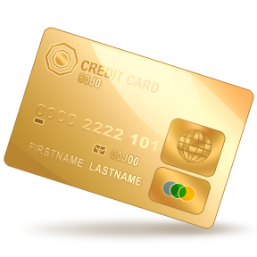
Ted’s parents have credit cards, so he knows they pay a bill each month to cover some of their expenses.
Credit - buy now and pay later
Credit card companies let consumers borrow money in exchange for charging interest and other fees.

Slide 4

First, Ted needs to learn the terminology used in all those credit card advertisements.

Slide 5

Common Credit Card Terminology
Credit card is a loan where unless you pay the bill in full each month, you owe a finance charge
Charge card is when the balance must be paid in full each month
Annual percentage rate: how much it costs each year to borrow from your credit provider

Slide 6
Cash advance: you can use your credit card to withdraw cash through a cash advance, but it usually costs extra
Credit report: identifies personal information about you and any credit accounts
  Equifax, Experian, TransUnion
Credit Score: identifies how “credit-worthy” you are
Grace period: tells how much time you have to pay your credit card bill without having to pay interest

Slide 7

Ted gets excited when he learns about the grace period. He thinks that whenever you make a purchase with your credit card he will have a grace period, so he won’t have to pay interest for a while.
Is this true or false? Why?
Notes:
False. Not all charges you make with your credit card have a grace period. That means sometimes you’ll be charged interest right away.

Slide 8
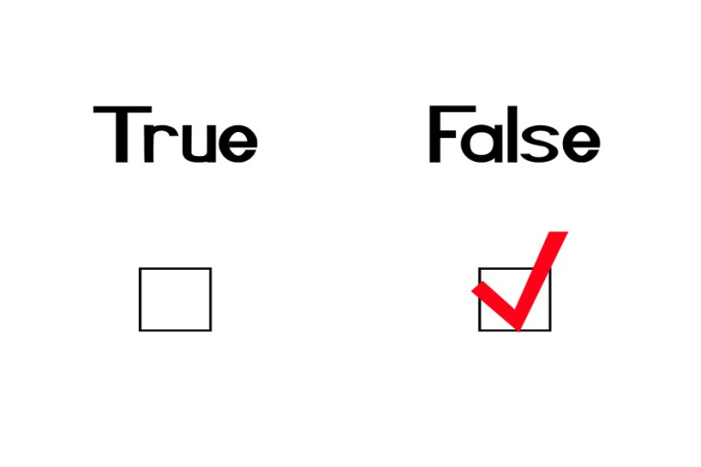
Not all charges you make with your credit card have a grace period. That means sometimes you’ll be charged interest right away.

Slide 9
Ted knows he may not have a high credit score because he is young and hasn’t had a lot of experience paying bills.
He learns the factors that impact his credit score:
Payment history
Amount owed
Length of credit
Amount of credit
Types of credit in use
Notes:
Be careful about signing up for a store credit card just to save a percentage off your purchase – opening that card could lower your credit score

Slide 10

Ted found two important credit-related websites :
www.annualcreditreport.com
www.optoutprescreen.com
Notes:
www.annualcreditreport.com: The only website that is guaranteed to give you access to each of your three credit reports once a year for free. Can get your credit report for free, but not your credit score
www.optoutprescreen.com: Allows you to opt out of receiving pre-approved credit card offers in the mail or via e-mail

Slide 11
While he was online, Ted saw an offer to view his credit report for free and he’s already viewed his three annual credit reports from www.annualcreditreport.com for the year.
Should he take the offer?
Notes:
No. www.annualcreditreport.com is the only website that is guaranteed to give you access to your credit reports for free. Beware of sites that might offer “free credit reports” but will charge you for their services.

Slide 12
Ted’s rights!
Credit CARD Act of 2009
Credit Card Accountability, Responsibility and Disclosure Act
Fair Credit Billing Act
Gives consumers the right to dispute unauthorized credit card charges of more than $50 with their credit card provider
Notes:
Credit CARD Act of 2009:
Prevents credit card companies from issuing credit cards to consumers under 21 years of age unless they demonstrate the ability to pay or have a co-signer
Bans interest rate increase within first year
Bans universal default, which is when a credit card company changes the terms of the loan based on the consumer defaulting with a different lender

Slide 13
Ted’s interest adds up…
Let’s say Ted charges $500 and only makes the minimum payments each month
How long will it take for Ted to finally pay off his balance?
Notes:
Based on an 18 percent interest rate and a minimum payment of $15 each month, it would take Ted 47 months to pay off his balance. This includes $198.34 in interest for borrowing the $500.

Slide 14
Credit card tips from Ted…
Charge only what you can afford and stay well within your credit limit
Save all receipts and compare with your credit card statements
Review credit card statements regularly online – many charges may appear right away
Exercise your right to opt out

Slide 15
Sign up for alerts (for example, when you spend a certain amount)
Do not give your credit card number to anyone you don’t know or trust
Shred unwanted credit card applications
Check each of your 3 credit reports for free once a year at www.annualcreditreport.com

Slide 16
Review Questions
How can users establish good credit?
What is the difference between a credit report and a credit score?
Why should students check their credit reports even if they have no credit in their name?
Notes:
1. Establishing good credit:
Always pay bills on time
Keep accounts open for a long time, even if you don’t always use them
Have different types of credit (for example, a credit card and a home mortgage)
Keep a significant gap between what you charge and your credit limit
2.
Credit report identifies personal information about you and any credit accounts
Credit score identifies how “credit-worthy” you are
3.
- Checking a credit report is important because someone maybe using your identity to receive credit in your name and social security number

Slide 17
Ted needs to borrow money for college!
Lesson 3: Borrowing Money, Part 2

Slide 18
Ted weighs the pros and cons of getting a student loan:
Positive
Negative
Makes college accessible and affordable
Helps pay for tuition, books, room and board, etc.
Can be expensive and difficult to pay off
Graduates who borrow can end up with a lot of debt than can hinder them from making other large investments

Slide 19

He learns about two types of loans
Federal loans
Regulated by federal government
More opportunities for cancellation & loan forgiveness
Notes:
Examples of federal loans include:
- Direct loans from U.S. Dept. of Education
- Fed. Family Education Loans
- Federal Perkins Loans

Slide 20
Private Loans
“Alternative loans”
Offered by private lenders
Don’t have same protections/benefits
Higher fees and interest rates

Slide 21
Scam Alert!!
Be cautious of loans or grants that require you to pay an up-front fee to apply. Many legitimate loans do not require up-front fees, meaning those that do may be scams!

Slide 22
Ted wants to avoid a large amount of student loan debt
68% of Ohio college students graduating in 2011 had debt, averaging…
$28,683
Notes:
Source: Project on Student Debt, an initiative of the Institute for College Access & Success

Slide 23
Before you take out a loan,
apply for federal student aid.
  www.fafsa.ed.gov
  Beware of private companies that charge to apply
If you take out student loans, use them only to pay for your education.

Slide 24
Review Questions
What are the differences between federal and private loans?
Where can you find more information about federal student aid?
Notes:
1.
Federal loans are regulated by the federal government
Private loans are offered by banks, typically at higher rates
Federal loans may be eligible for loan forgiveness, for example- if you work for certain governmental entities
2. www.fafsa.ed.gov

Slide 25
A Short Quiz!
Private student loans, also referred as “alternative loans,” tend to have higher fees and interest rates than federal government loans. True or False?
2. Which of the following is a factor that impacts your credit score?
  a - Amount owed
  b - Payment history
  c - Types of credit in use
  d - All of the above
Notes:
1.
True: Private loans tend to have higher fees and interest rates and may not include the benefits and protections available with federal loans. Federal loans also offer more opportunities for cancellation and loan forgiveness.
2.
D - All of the above

Slide 26
Quiz (cont.)
3. You can check your credit report for free three times a year. True or False?
4. You are making a purchase online and trying to decide whether to use your credit card or your debit card. It’s usually safer to pay with a credit card, because credit card transactions are protected under federal law. True or False?
5. List one pro and one con of taking out a student loan.
Notes:
3.
True: Check your credit report periodically to check for signs of identity theft. You can check your report three times a year for free (once from each of the three major credit reporting companies) from this central Web site: www.annualcreditreport.com
4.
True: Credit card transactions are protected under the federal Fair Credit Billing Act, which allows consumers to dispute unauthorized charges to their accounts within 60 days.
5.
List one pro and one con of taking out a student loan.
Possible response:
Pro: helps students pay for tuition, room and board, books, and other costs associated with attending college
Con: can be difficult to pay off

