Slide 1
Sally Buys a Car!
Lesson 2: Auto Repairs and Services
Notes:
Students have a lifetime of consumer decisions: When they know their rights they will not only obtain wealth- they will keep it.

Slide 2

Meet Sally!
This is Sally. She needs a new car. She decides to research what rights she has when purchasing a car. Let’s see what she discovers!

Slide 3
First, Sally wants to know the return policy:
How many days does Sally have to return a car after she purchases it?
What else should Sally think about before purchasing a car?
Notes:
There is no return policy for cars under the CSPA or other Ohio laws. Dealerships may offer return policies or promotions, but generally there is no right to cancel the purchase of a car.

Slide 4
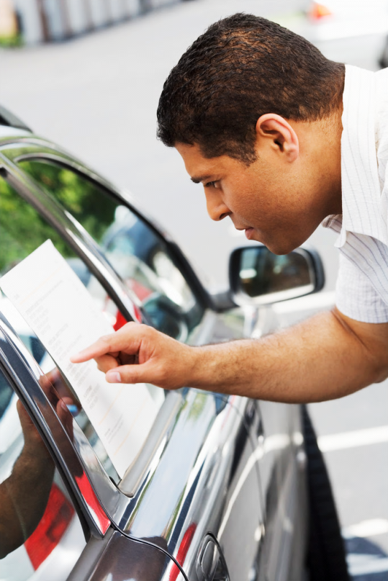
Sally should research:
Price
  Use a variety of methods to compare prices and models
  The invoice price (for a new car)
  Any available rebates
Dealership’s Reputation
Recalls and safety features
Notes:
Buying a car
Before buying or leasing a new or used car, thoroughly research your options. Auto and consumer Web sites, books, and magazines can help you compare prices and model options. Check a dealership’s reputation with consumer agencies, including the Ohio Attorney General’s Office and the Better Business Bureau, as well as with family and friends.
Once you decide on a vehicle, research how much the dealership paid for a new car (the invoice price) and if there are available rebates (money back for your purchase). Check for recalls and safety features.

Slide 5

She should also find out about:
The vehicle’s history – where the car has been. Example - Wouldn’t you want to know if it was flooded by Hurricane Sandy?
  www.vehiclehistory.gov
Who has the vehicle’s title
  www.publicsafety.ohio.gov
Discuss the purchase with family or trusted friends.
Notes:
If you are buying a used car, check the vehicle’s history with the Ohio Bureau of Motor Vehicles (www.bmv.ohio.gov) and the National Motor Vehicle Title Information System (www.vehiclehistory.gov) by running a title search. You also may use one of several Internet-based history report services, but be aware that these reports do not always reflect the full vehicle history.
Car titles
A certificate of title is a document that proves ownership of a vehicle. In order to drive legally in Ohio, your vehicle must be registered with the Bureau of Motor Vehicles. Additionally, a dealership must provide a title to you within 30 days of the date you purchase the vehicle. If the dealer doesn’t deliver your title on time, you should file a complaint with the Ohio Attorney General’s Office. The office will work with the Bureau of Motor Vehicles and the dealership to get your title.

Slide 6

Sally found her car!
Sally wants to buy this car, and it’s in her price range! What should Sally know before she starts to negotiate the price and pay for the car?

Slide 7

She should…
Understand payment options:
  Pay in full
  Finance
  Lease
Consider negotiating the price based on final cost rather than monthly payment
Consider discussing trade-ins after finalizing the purchase price.
Notes:
Base negotiations on total purchase price (instead of monthly payment) and search dealerships for lowest annual percentage rate (APR).
Consumers might consider:
- Not telling a dealership how much you can afford to pay each month. Doing so may allow the dealer to offer to stretch out the loan over more months or get you to bump up the monthly payment. Instead, negotiate the total purchase price first.
- Discussing trade-in prices after finalizing the price of the new purchase. Trade-in price can also be negotiated, making for two straight-forward negotiations.

Slide 8

Sally’s rights!
The car Sally’s purchasing is “as is.” What does that mean?
Under the CSPA Sally can:
  Take the car for a test-drive
  Take the car to an independent mechanic for a thorough inspection
Notes:
A used car sold “as is” is not protected by warranty. Consumers do not have the right to cancel or return a vehicle after they buy it (so they need to check for any problems hidden beneath the surface!)
If you buy a car “as is,” you are responsible for paying for any problems that occur after the purchase even if it falls apart driving off the lot.

Slide 9
Sally thought about searching for a car online…
She discovered these tips:
  Get everything in writing.
  Check the seller’s reputation.
  See the car in person (bring an adult with you) and test drive before sending money.
  Don’t trust pictures on the Internet.
  Pay with credit if possible.
  Scams
Notes:
Paying with credit allows you to dispute unauthorized charges. Harder to receive compensation if you pay with cash and it is spent or sent overseas.
If you are purchasing a car online from an individual, he or she may want cash. Just be careful and do not conduct a transaction until you’ve inspected and driven the car.
If it’s not written in the contract, it’s not guaranteed.

Slide 10
Sally learned to watch for car scams…
Be cautious of online marketplace sellers who want payment sent right away, especially through wire transfers or money card
Do not provide personal information – it could be used to steal your identity
Do not make a large “down payment”
Be careful if the company has no physical address – only a P.O. box
Notes:
Online marketplaces are Craigslist, E-bay, etc.

Slide 11

Lemon Law
A lemon is a new car with serious problems that affect the car’s use, value or safety
The manufacturer must have a reasonable opportunity to repair. If they fail to fix the problem, you may be entitled to a full refund.
Get all repair information in writing.
Notes:
Lemon Law: A lemon is a new car with a problem or problems, covered by the warranty, that substantially decrease the use, value, or safety of the vehicle. It covers vehicles within the first year of use or first 18,000 miles, whichever comes first. If you think you have a lemon, take it back to the dealership. The manufacturer (e.g. Ford, Honda, GM) has a reasonable opportunity to repair the lemon. The “reasonable opportunity” varies depending upon the seriousness of the problem– manufacturers have fewer chances to repair life-threatening problems. If the car is not repaired after the manufacturer has had a reasonable opportunity, you are entitled to a refund of the full purchase price.
No right to cancel: Under Ohio law, you do not have the right to cancel the deal after purchasing a car.

Slide 12
Video: Ohio Attorney General’s Office
http://www.youtube.com/watch?v=oIggaUu_HNw
Notes:
The length of the video is 57 seconds.
Source: http://www.youtube.com/watch?v=oIggaUu_HNw

Slide 13
Review Questions
When buying a car, what are some tips for negotiating the price?
When purchasing a car, what should be taken into consideration?
Why should you get all information in writing?
Notes:
Q1:
Propose trading in a vehicle only after a price has been determined
Base negotiations on total cost, not monthly payments
Q2:
Do diligent research – compare numerous prices and models and check the credibility of any dealers you are considering purchasing from.
Examine these factors:
Dealership’s reputation
Invoice price
Available rebates
Recalls and safety features
Vehicles’ history
Q3:
Get any verbal promises in writing. If the seller tries justifying a higher price with additional features, writing this down will make them more easily subject to legal action if the car does not actually posses these features.

Slide 14
Sally needs her car repaired!

Slide 15
Under Ohio’s Repairs and Services Rule, consumers have the right to a verbal or written estimate for repairs or services that will cost more than $25.
If the customer requests it, the estimate must include:
  Description of work that will be done
  Anticipated date of completion
  Expected cost

Slide 16
Requesting a written estimate is best
For additional repairs that cost more than 10% of the original estimate, the business must get the consumer’s authorization
Notes:
Information concerning other related charges (like pickup and delivery or diagnostic work) must be made available to the customer.
In any repair/service transaction, supplier also must disclose:
Charges for disassembly, reassembly
Charges for work that only gets partially completed
Storage charges
Service charges, travel charges, charges for diagnosis
If work will be performed by third party, if disclaiming warranty of that work

Slide 17
The business must…
  provide an itemized list of all tasks performed if requested
  return all replaced parts unless agreed otherwise

Slide 18

Tips for Choosing a Repair Shop
Ask family and friends for recommendations.
Check shop’s reputation
Get at least 3 different estimates
Make sure shop will honor warranties
Ask if they use new or used parts
Ask about guarantees and get them in writing
Save copies of estimates, invoices, receipts, etc.
Notes:
Following these tips will help prevent payment of excessive charges and poor quality repairs
Getting things in writing helps ensure compliance and allows for legal action in the case of default. If you call the AG’s office and file a complaint, it will be more likely to help solve the problem if you have such agreements in writing

Slide 19
Review Questions
Under what conditions are consumers entitled to an estimate?
What information should consumers gather from a repair shop before work begins?
Notes:
Q1:
Under Ohio’s Repairs and Services Rule, consumers have the right to a verbal or written estimate for repairs or services that will cost more than $25.
For additional repairs that cost more than 10% of the original estimate, the business must get the consumer’s authorization for the additional cost. This helps ensure that the actual cost does not significantly differ form the estimate
Information about other related charges (like pickup and delivery) should also be made available
Q2:
Description of work that will be done
Anticipated date of completion
Expected cost
Information about guarantees offered (in writing)
Whether the shop uses new or used parts
Warranty

Slide 20
Video: From CBS
http://www.youtube.com/watch?v=nvcuM8sRhB4
Notes:
The length of the video is 5 minutes, 10 seconds.
Source: http://www.youtube.com/watch?v=nvcuM8sRhB4

Slide 21
A Short Quiz!
When shopping for a car, it’s important to request any verbal agreements or promises be put in writing: True or False?
How many days do you have to cancel an automobile purchase?
30
3
10
None
Notes:
1.
True: Always insist that any verbal promises the dealer makes are included in the written contract. Otherwise, they are not guaranteed.
2.
None (This is a common misconception! Cancellation rights apply only to a few types of contracts)

Slide 22
Quiz (cont.)
3. Ohio’s Lemon Law covers all motorized vehicles, regardless of the year or mileage: True or False?
4. If you buy a car “as is,” who is responsible to pay for any problems that occur after the purchase is made?
Car dealer
Consumer
Car manufacturer
None of the above
Notes:
3.
False: Ohio’s Lemon Law does not cover vehicles more than one year old or driven more than 18,000 miles.
4.
Consumer: A car that is bought “as is” does not come with a warranty. Therefore it is the consumer’s responsibility to pay for any problems that occur with the vehicle after the purchase is made.

