Slide 1

CARES Program Rollout 2
March Client Update
March 17, 2023

Slide 2
Objectives & Logistics
AGO Collections modernization initiative
Objectives
  Provide Rollout 2 Status Updates
    Program Timeline, Iteration Plan and Scope
    Interface and SFTP Adoption Timeline
    Portal Implementation
    Data Migration
Logistics
  Session will be recorded and made available along with PowerPoint
  Send questions to AGOCARES@OhioAGO.gov

Slide 3

Program Timeline Update

Slide 4
AGO Collections modernization initiative
Rollout #2 – Program Timeline
We are here

Slide 5

Rollout #2 – Iteration Plan & Scope
AGO Collections modernization initiative
Scope is sequenced and prioritized in the Iteration Plan based on risk, business value, and their dependency on other functionality and priorities. These items have been built and are currently under system testing for AGO’s concurrence prior to User Acceptance Testing.
Iteration 1
Iteration 2
Iteration 3
Iteration 4
Workflows
Forward Strategy
Admin Fee Processing
SC Court Costs
Integration
Trustee Checks
BMV Hold Release Outbound
DPSC Certifications Inbound
Client Financial Inbound
Other
Letters/Reports
Data Migration
Workflows
Forward Strategy
Vendor Payments
Reso Walk-Ins
Reso Chat
Integration
Client Financial Inbound
Client Financial Outbound
TPV/SC Placement Outbound
TPV/SC Maint. Outbound
TPV/SC Maint. Inbound
Other
Letters/Reports
Data Migration
Workflows
Vendor Payments
Reso Title Desk/Payoffs
Integration
TPV/SC Recall Outbound
TPV/SC Recon Outbound
Liquor Holder.txt Inbound
OLC Real-Time Inbound
Other
Letters/Reports
Data Migration
Workflows
Title Desk/Payoffs
DOH Smoking Ban Accounts
OIC (Offer in Compromise)
Dual Make Whole
Portal
Integration
Client Financial Outbound
OLC Real-Time Inbound
Other
Letters/Reports
Data Migration
Iteration 5
Iteration 6
Iteration 7
Workflows
DOH Smoking Ban Accounts
OIC (Offer in Compromise)
Reso Email Box
Reso TPV/SC Email Box
Portal
Integration
TOS Check/ACH Response (NACHA)
OLC Payment File Inbound
Other
Letters/Reports
Data Migration
Workflows
Archive and Write Off
Statute of Limitations
Reso TPV/SC Email Box
Integration
N/A
Other
Letters/Reports
Data Migration
Workflows
Statute of Limitations
Liquor
Intake Mailroom (Mail Sorting/Distribution Process)
Intake Overnight Mail
Integration
N/A
Other
Letters/Reports
Data Migration

Slide 6
Implementation Progress
AGO Collections modernization initiative
Below are relevant updates on progress since we met in January.
Setting Up Secure File Transfer Protocol (SFTP)
  Provided credentials to several of you that and are working with others in transferring TEST files to confirm STFP configuration
Confirming Certification File Standard
  Received Certification TEST file transferred via SFTP to the AGO from those who obtained credentials
  AGO tested and validated several client certification files and sent confirmation to each
Portal
  Completed DM Portal design and development
  AGO is currently testing the Portal for concurrence prior to initiating User Acceptance Testing
Notes:
Read Slide

Slide 7
Interface and SFTP Adoption

Slide 8
Implementation Progress
AGO Collections modernization initiative
Client and SC/TPV Setting Up SFTP
  Provided credentials to several Clients and external partners (SC/TPVs) that have requested to use the Secure File Transfer Protocol (SFTP)
  Worked with several of you in transferring TEST files to confirm STFP configuration
Notes:
Read Slide

Slide 9
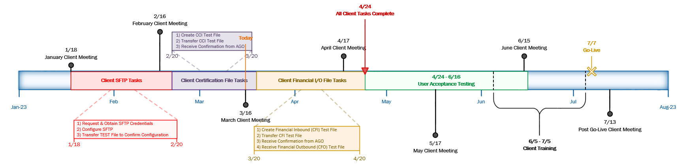
Interface & SFTP Adoption Timeline
AGO Collections modernization initiative
February 20, 2023
  Client SFTP Tasks Complete
    Request & Obtain SFTP Credentials
    Configure SFTP application
    Transfer TEST File using SFTP to Confirm Configuration
March 20, 2023
  Client Certification Tasks Complete
    Create & transfer CCI TEST File via SFTP application
    Receive Confirmation from AGO
April 20, 2023
  Client Financial I/O Tasks Complete
    Create & transfer Financial Inbound (CFI) Test File via SFTP application
    Receive Confirmation from AGO
    Receive Financial Outbound (CFO) Test File
April 24, 2023
  All Client Tasks Complete
April 24, 2023
  User Acceptance Testing begins
    With limited Client participation
June – July, 2023
  Client Training begins
    Client Training is being finalized (Virtual Delivery)
June 19, 2023
  Go Live Prep begins
    SCS Debt Manager system prepared for launch and final SCS data from CUBS being setup for migration to Debt Manager at launch time

Slide 10
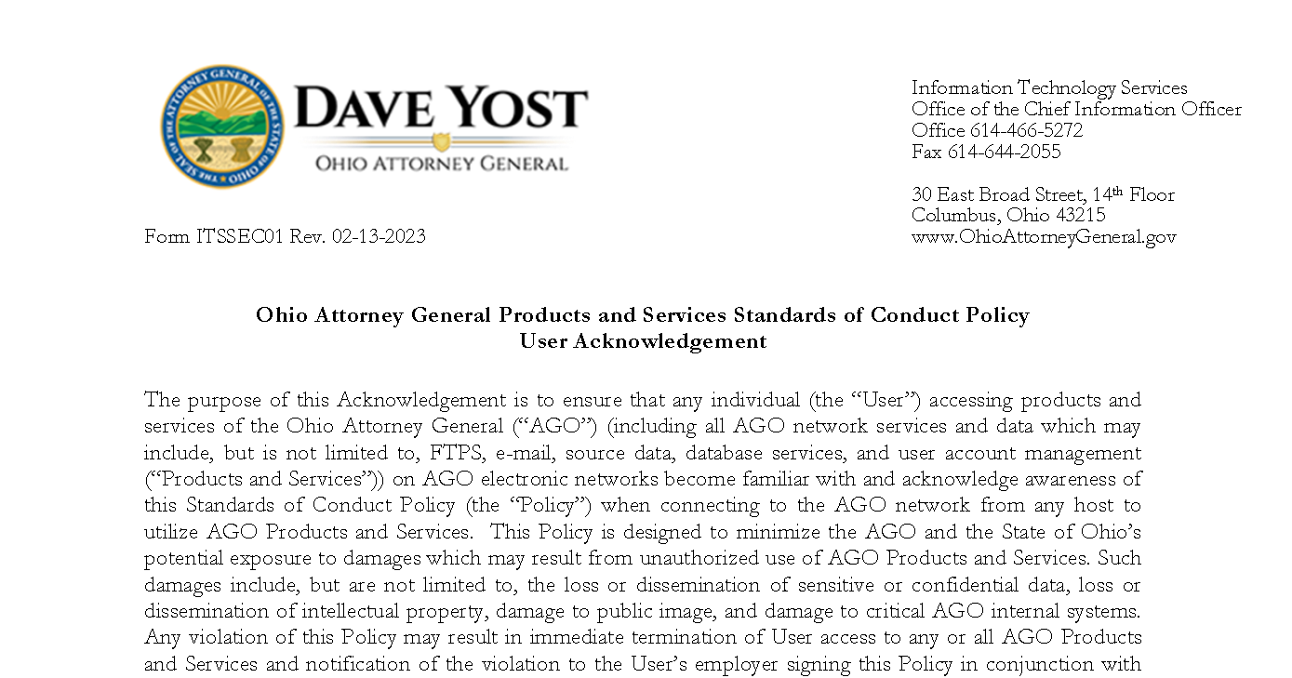
Form ITSSEC01
(Required for Certification File Exchange)

Slide 11
Forms Status
AGO Collections modernization initiative
Realistically have until mid-April to get this done
  Processing takes time and we need your partnership to get these forms in ASAP
  Prioritizing ITSSEC01 over the next two weeks
    Those listed below, please reach out to the AGOCARES inbox and we will coordinate directly with you AGOCARES@OhioAGO.gov
Adjutant General, Education, Health, MHAS, Transportation, Veterans Services, Higher Education, PYT, Inspector General, Elections Commission, Lottery, Public Safety, and STRS

Slide 12
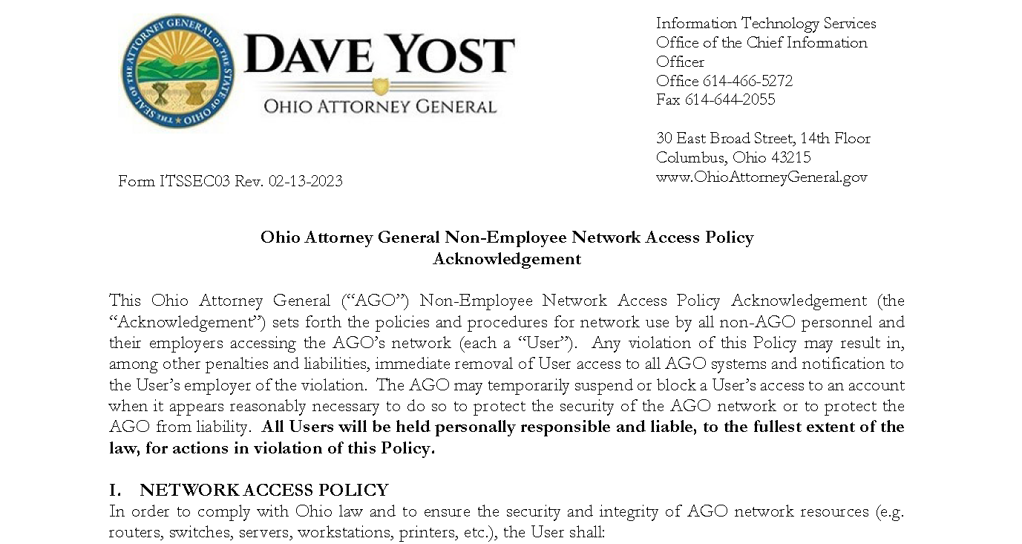
Form ITSSEC03
(Required for Portal Access)

Slide 13
Portal Development

Slide 14
Portal Implementation
AGO Collections modernization initiative
What does it do:
Primary means by which Clients and External Partners will be accessing reports
Also allow for account-specific updates to augment file exchange
Where are we in implementation:
Completed DM Portal design and development
Currently testing the Portal prior to initiating User Acceptance Testing
Notes:
Read Slide

Slide 15
Data Migration Process

Slide 16
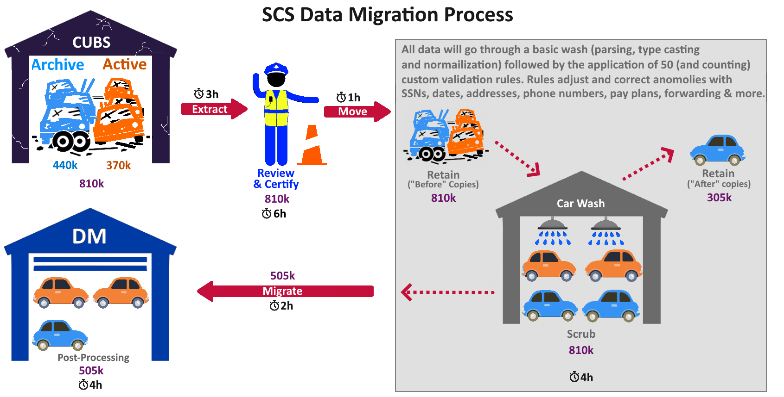
* We may need your assistance with corrections. However, this remains to be determined at this time based on what data quality issues are identified

Slide 17




CARES Resources
AGO Collections modernization initiative
The CARES leadership team is dedicated to transparency; In addition to the development of engagement strategies intended to keep stakeholders informed, the following resources and channels of communication are always available to those impacted by the CARES Program.
CARES Website
This website serves as your resource for the most up-to-date Program information and updates
CARES Mailbox
The AGOCARES mailbox will be used by the program team to distribute CARES communications to stakeholders and respond to inquiries regarding the Program.
Stakeholder Contacts
Stakeholder POCs serve as a direct resource, providing a channel of communication between each audience and the Program team
Have questions, feedback or concerns? Please email the AGO’s CARES Program team at AGOCARES@OhioAGO.gov or visit the CARES Website at https://www.ohioattorneygeneral.gov/Business/Collections/CARES-Program/About
17
Notes:
In addition to direct communication from the CARES Program, all stakeholders are encouraged to utilize these additional resources to inquire or ask questions about the CARES Program.

Slide 18

Thank You!

